Slide 1


FAKE NEWS DETECTION
Department of Computer Science
Presented by
Nikhil Gangisetty
Sandeep Sai Bollineni

Slide 2
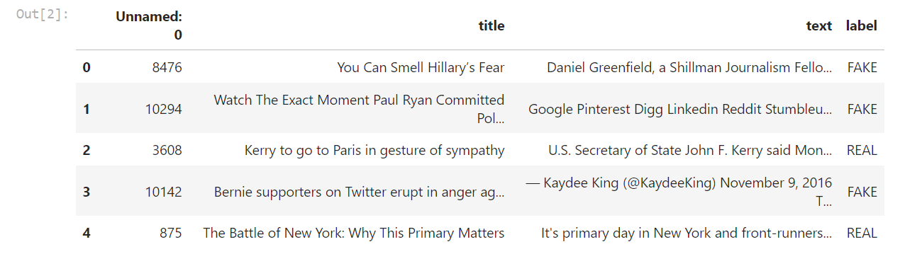
Introduction
This how the Corpus is look like :
It has three Categories Title , Text , Label
Notes:
Highlight the benefits of IoT and the interconnectedness of devices, but also emphasize the security risks and vulnerabilities that arise from this interconnectedness.

Slide 3
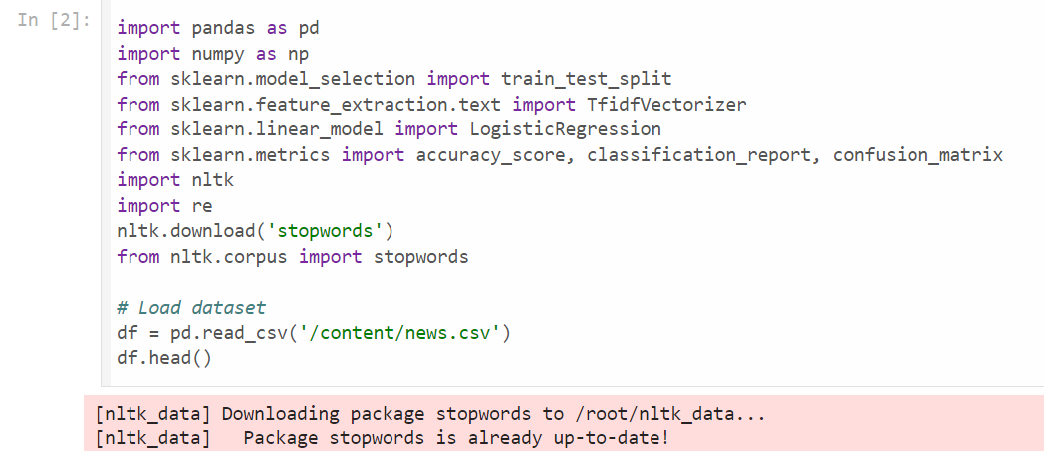

Slide 4
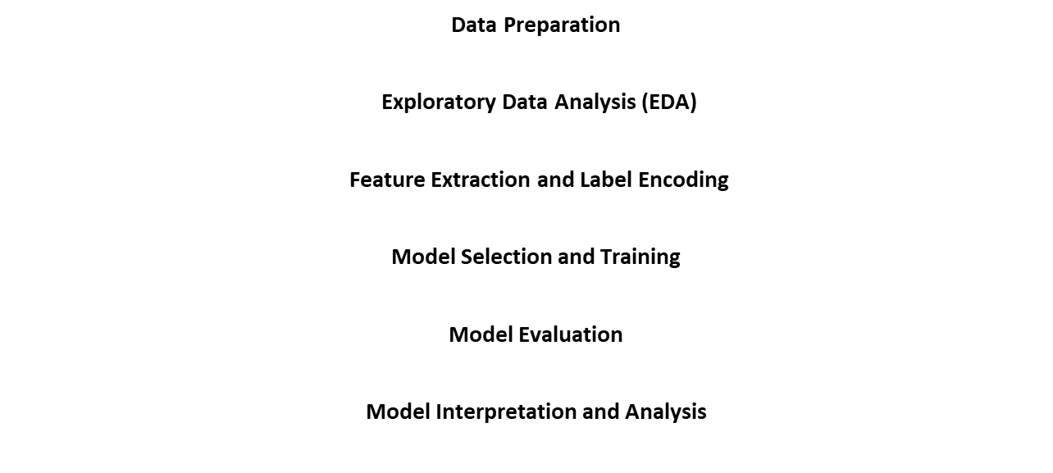
METHODOLOGY
Notes:
Emphasise the severity of botnet threats in IoT networks and the need for robust detection and prevention techniques. Introduce the research objectives of evaluating and comparing solutions.

Slide 5
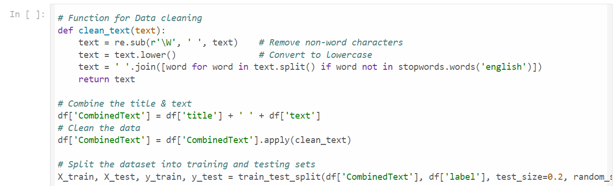
Data preparation
Notes:
Briefly explain the working principles of the DNNBoT and CNN-LSTM models, highlighting their respective advantages and limitations.

Slide 6
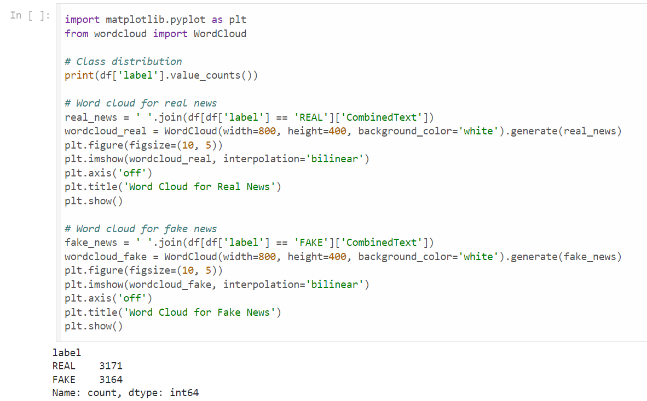
Exploratory data analysis(EDA)
Notes:
Explain the signature-based approach of Snort and its limitations, as well as the multi-classifier ensemble technique and its potential applications.

Slide 7
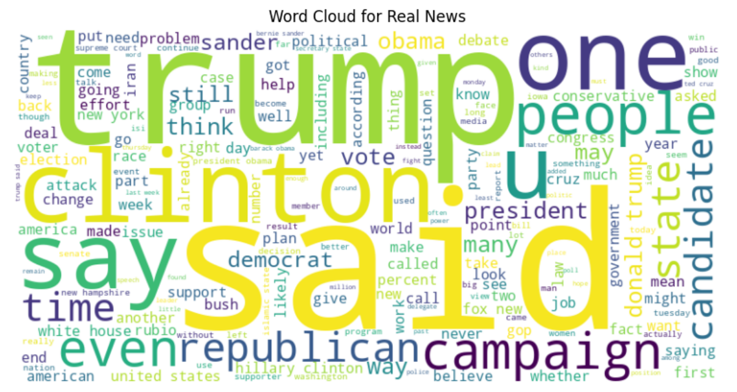
Work Cloud for Real news

Slide 8
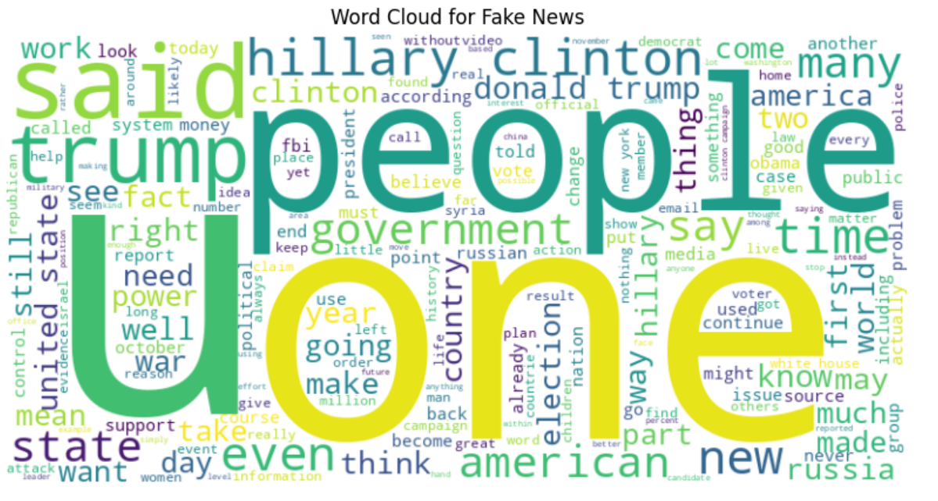
Work Cloud for Fake news

Slide 9
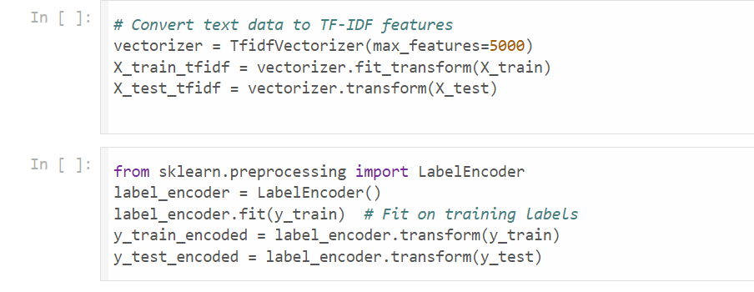
Feature Extraction and Label encoding
TF-IDF (Term Frequency-Inverse Document Frequency) quantifies the importance of a word in a document relative to a corpus. TF measures how frequently a term appears in a document, while IDF measures how important a term is across the corpus by reducing the weight of common terms. TF-IDF combines these measures to provide a score indicating the term's relevance.
Vectorization transforms text into numerical vectors using TF-IDF scores, enabling text data to be used in machine learning models. This process includes tokenization, calculating TF and IDF, computing TF-IDF scores, and creating feature vectors for each document.
Notes:
Highlight the stacking ensemble approach and its high accuracy, while acknowledging its computational complexity. Discuss the open feature set and its versatility across datasets.

Slide 10
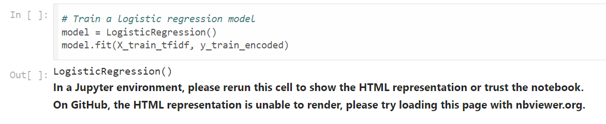
Model Selection and Training
Logistic Regression:
Logistic regression is a statistical method used for binary classification. It models the probability that a given input belongs to one of two categories. The technique employs the logistic function (sigmoid) to convert a linear combination of input features into a probability score, which is then used to classify the input into one of the two possible outcomes. Logistic regression is widely used for its simplicity and effectiveness in scenarios where the dependent variable is categorical and binary.
Notes:
Explain the hybrid approach of autoencoders and decision trees, highlighting its effectiveness in handling unbalanced data. Discuss the DNN model's high accuracy and real-time detection capabilities.

Slide 11
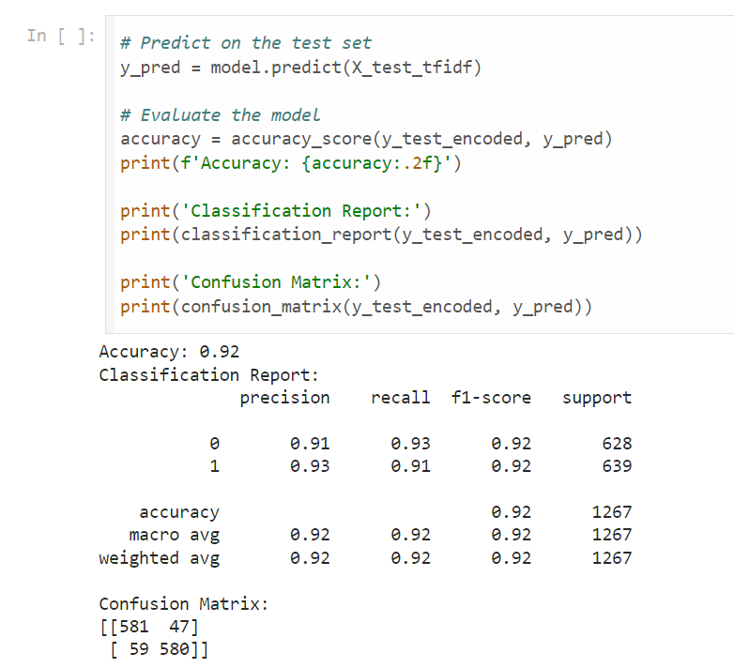
Model Evaluation
Notes:
Discuss the Decision Tree classifier's ultra-fast analysis and scalability, while noting its potential limitations. Explain the hybrid optimization algorithms and their balance between exploration and exploitation.

Slide 12
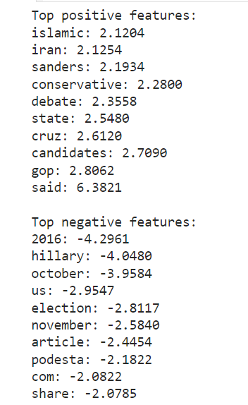
Model Interpretation and Analysis

Slide 13

MISCLASSIFIED
Misclassified examples: 106
Example:
Notes:
Highlight the stacking ensemble approach and its high accuracy, while acknowledging its computational complexity. Discuss the open feature set and its versatility across datasets.

Slide 14


